Slide 1
Parking Management System
Planning with Trello • Documentation & Version Control with GitHub
Course / Module Name : CSE 220
Instructor: Poshan Karki
Team: Dinesh and Samjhana

Slide 2
Agenda
Introduction, Scope and Team Roles
Agile Methodology: The Scrum Framework
Requirement Analysis
Modelling the System: UML Diagrams
Product Backlog and Sprint Planning with Trello
Testing Strategy
Reflections on Using Agile Tools & Conclusion
References

Slide 3
01 INTRODUCTION
Introduction, Scope & Team Roles
This project is based on an Agile approach to develop a Parking Management System (PMS). The main goal is to learn how software projects are planned and managed in a real-world environment. Instead of coding, it’s focuses on creating project documents, managing tasks in Trello, and maintaining project files in GitHub. Team members collaborate, track progress, and follow Agile practices such as planning, task assignment, and version control. This helps to understand the complete software development process and teamwork.
Team Roles & Responsibilities
Project Scope
Team member | Core Responsibility
Dinesh | Manages and prioritizes the product backlog, monitors progress, removes blockers, and manages GitHub repositories, branches, pull requests, and merges.
Samjhana | Gathers and analyzes requirements, prepares project documentation and UML diagrams, designs test cases and ensures quality standards are met.
In Scope: We are working on vehicle entry and exit tracking, parking slot allocation, fee calculation, reservation management, and reporting workflows within the Parking Management System.
Out of Scope: Hardware sensor integration, payment gateway implementation, and mobile application coding are not included in this project.
Deliverables: We will produce a project plan, requirement and design documents, UML diagrams, test cases, and evidence of project management and collaboration using Trello and GitHub.
Parking Management System: Agile Project Simulation
1

Slide 4
02 PROCESS FRAMEWORK
Agile Methodology: The Scrum Framework
We follow the Scrum framework, an Agile methodology that promotes teamwork, continuous improvement, and regular feedback. Scrum helps us manage the project through short, fixed-length iterations called Sprints. During each sprint, we plan tasks, track progress, review outcomes, and make improvements based on feedback. This approach ensures transparency, effective collaboration, and the timely delivery of project goals.
Core Agile Principles
1
Prioritize individuals and interactions over processes and tools.
2
Focus on creating useful project outcomes and documentation rather than excessive upfront specifications.
3
Encourage collaboration and communication among team members throughout the project.
4
Remain flexible and adapt to changes when project requirements or priorities evolve.
Parking Management System: Agile Project Simulation
2

Slide 5
03 DOCUMENTATION & DESIGN
Requirement Analysis
Requirement analysis helps us identify the stakeholders of the Parking Management System and understand their needs and expectations. It defines the system's functional and non-functional requirements, ensuring that all project objectives are clearly documented. The information gathered during this phase serves as the foundation for our GitHub-hosted requirement documents, user stories, and UML diagrams. This process helps us create a clear and well-structured project plan before moving to design and testing activities.
S
Stakeholder Analysis
Identifying and understanding project stakeholders' needs.
Primary:
Drivers: Use the system to find, reserve, and manage parking spaces.
Parking Staff: Monitor vehicle entry/exit and manage parking operations.
Administrator: Manages users, parking slots, reports, and system settings.
Secondary:
Facility Owner: Reviews system performance and operational reports.
Auditors: Examine records and reports for compliance and verification purposes.
Technique: Use a Power–Interest Grid to identify stakeholders and prioritize their involvement based on their level of influence and interest in the project. This helps us manage communication and engagement effectively throughout the project lifecycle.
Parking Management System: Agile Project Simulation
3

Slide 6
3.1 Functional Requirements
Define what the system does:
Register Vehicle Entry and Exit: Record vehicle arrival and departure details.
Allocate Available Parking Slots: Assign available parking spaces to vehicles efficiently.
Calculate Parking Fees: Automatically determine parking charges based on the duration of parking.
Generate Occupancy Reports: Produce reports showing parking space usage, availability, and occupancy statistics.
ID | Functional requirement | Description
FR-01 | User Registration | The system shall allow users and parking staff to register their accounts.
FR-02 | User Login | The system shall allow authorized users to log in using valid credentials.
FR-03 | Vehicle Registration | The system shall allow parking staff to register vehicle details such as vehicle number, type, and owner information.
FR-04 | Parking Slot Management | The system shall allow administrators to add, update, and manage parking slots.
FR-05 | Slot Availability | The system shall display the current availability status of parking slots.
FR-06 | Parking Slot Allocation | The system shall assign an available parking slot to a vehicle during entry.
FR-07 | Vehicle Entry and Exit | The system shall record vehicle entry and exit date and time.
FR-08 | Parking Fee Calculation | The system shall calculate parking fees based on the duration of parking.
FR-09 | Payment Management | The system shall record parking payments and their payment status.
FR-10 | Report Generation | The system shall generate parking reports, including vehicle, parking, and payment records.
4

Slide 7
3.2 Non-Functional Requirements
Define how well it performs:
Performance: Response time should be within 2 seconds.
Availability: The system should provide 99% uptime.
Security: Access should be controlled based on user roles.
Usability: The system should work well on both mobile and desktop devices.
ID | Non-functional requirement | Description
NFR-01 | Performance | The system should respond to normal user requests within 2 seconds.
NFR-02 | Security | The system shall protect user and parking information from unauthorized access.
NFR-03 | Reliability | The system shall accurately store and maintain vehicle, parking, and payment records.
NFR-04 | Availability | The system should be available whenever the parking facility is operating.
NFR-05 | Usability | The system interface should be simple, clear, and easy for parking staff to use.
NFR-06 | Scalability | The system should support an increasing number of users, vehicles, and parking slots.
NFR-07 | Maintainability | The system should be easy to maintain, update, and modify when requirements change.
NFR-08 | Data Integrity | The system shall maintain accurate and consistent parking and payment information.
NFR-09 | Backup and Recovery | The system should regularly back up important data and allow recovery after system failure.
NFR-10 | Compatibility | The system should work correctly on commonly used modern web browsers and supported devices.
5

Slide 8
04 DOCUMENTATION & DESIGN
Modelling the System: UML Diagrams
UML (Unified Modeling Language) is a standard way to use diagrams to show how a system works. Different UML diagrams help us understand different parts of a system, such as its requirements, structure, activities, and behavior.
UC
CL
SQ
AC
Use Case Diagram
Class Diagram
Sequence Diagram
Activity Diagram
Shows the different users, such as driver, staff, and admin, and the functions they can perform in the system.
Shows the main parts of the system, their information and functions, and how they are connected. For example, Vehicle, Slot, and Ticket are classes in a Parking Management System.
Shows the step-by-step flow of messages between different parts of the system for a specific process, such as vehicle entry and fee payment.
Shows the step-by-step workflow of a process, including decisions and actions, such as assigning a parking slot and clearing a vehicle at exit.
Parking Management System: Agile Project Simulation
6

Slide 9
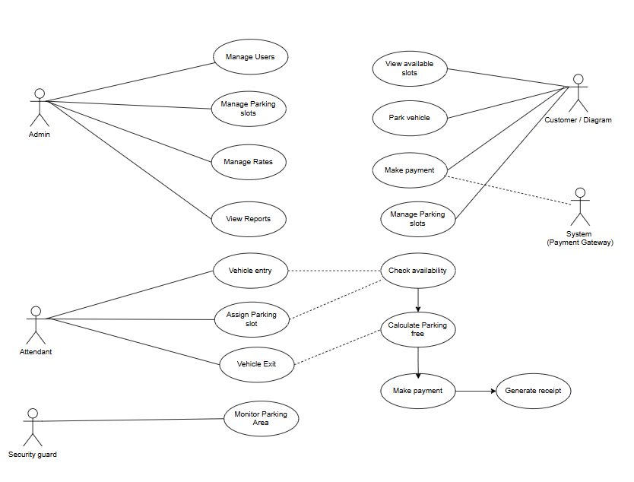
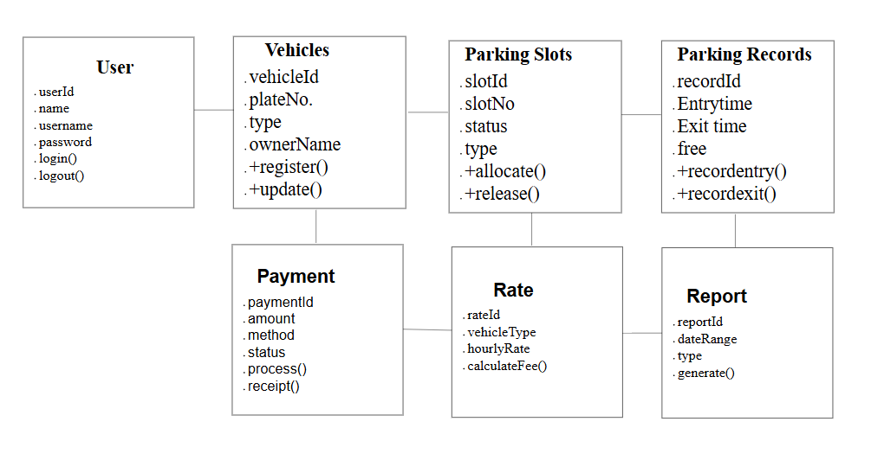
4.1 Uses Cases and Class Diagram
Uses Cases Diagram
Class Diagram
7

Slide 10
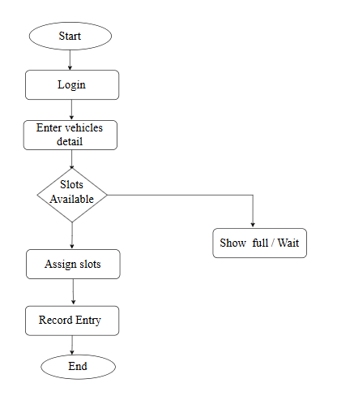
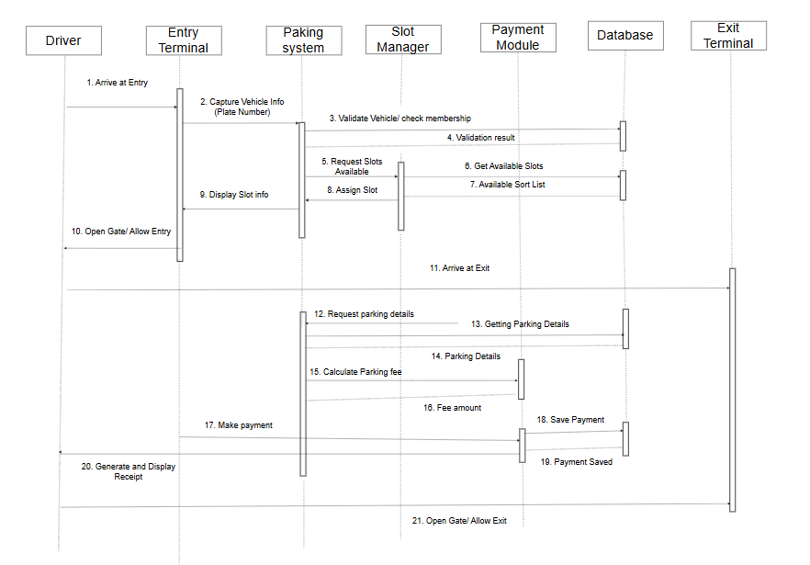
4.2 Sequence and Activity Diagram
Sequence Diagram
Activity Diagram
8

Slide 11
05 PROJECT MANAGEMENT
Product Backlog and Sprint Planning with Trello
The Product Backlog contains all user stories, written in the standard format “As a [role], I want [goal], so that [benefit].” We estimate each story using story points and prioritize them before selecting stories for a Sprint.
5.1 Product Backlog: Diagram
ID | User Story | Pts | Priority
US-01 | As a driver, I want to search available slots so that I can park quickly | 5 | High
US-02 | As a driver, I want to reserve a slot online so that space is guaranteed | 8 | High
US-03 | As an attendant, I want to log vehicle entry/exit so that duration is tracked | 5 | High
US-04 | As a system, I want to calculate fees automatically so that billing is accurate | 8 | High
US-05 | As an admin, I want a live occupancy dashboard so that I can monitor usage | 5 | Medium
US-06 | As a driver, I want to pay via mobile wallet so that checkout is fast | 8 | Medium
Parking Management System: Agile Project Simulation
9

Slide 12
5.2 Sprint 1 : Diagram
ID | User Story | Owner | Pts | Priority | Status | Due
US01 | Admin Login | Samjhana | 3 | High | Done | Day 5
US02 | Dashboard | Samjhana | 5 | High | In Progress | Day 6
US03 | Vehicle Registration | Samjhana | 5 | High | In Progress | Day 7
US04 | Parking Slot Management | Samjhana | 5 | High | To Do | Day 8
US05 | System Navigation | Dinesh | 3 | Medium | To Do | Day 9
10

Slide 13
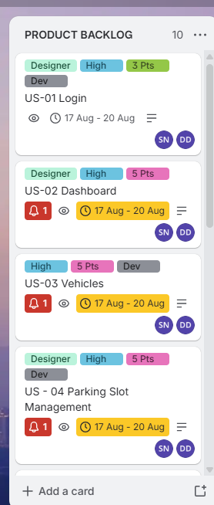
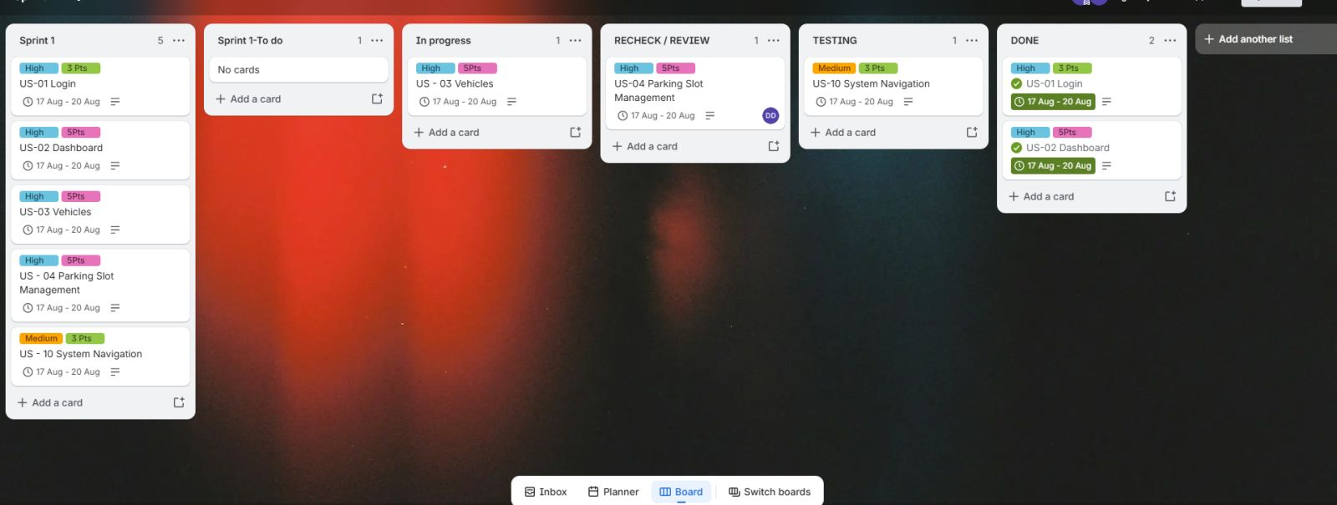
5.3 Sequence and Activity Diagram
Diagram of Product Backlog
Diagram of Spring 1
11

Slide 14
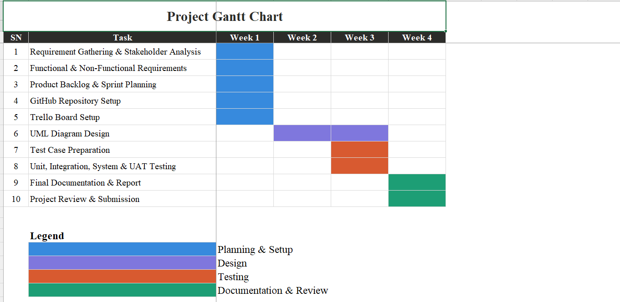
5.3 Gannt Chart
A Gantt chart helps us visualize the timeline, schedule, and progress of Sprint 1 tasks. We created it using tools such as Excel or Gantt Project to track task durations and deadlines
12

Slide 15
06 TESTING
Testing Strategy
Testing helps us verify that the system meets the defined requirements through four testing levels, with each test documented using a Test ID, objective, input, expected output, actual output, and status for clear and organized tracking.
U
I
SY
UAT
Unit Testing
Integration Testing
System Testing
User Acceptance Testing
Checks individual components separately, such as the parking fee calculation.
Checks that different modules work together correctly, such as vehicle entry logging and slot allocation.
Checks the complete system from start to finish against the defined functional requirements.
Confirms that the system meets stakeholder needs in real-world scenarios.
Parking Management System: Agile Project Simulation
13

Slide 16
6.1 Test Case Example
Type | Objective | Input | Expected Output | Actual Output | Status
Unit (TC-U01) | Verify fee-calculation function returns correct charge for duration | Entry 10:00, Exit 12:00 (2 hrs), Rate = $2/hr | Fee = $4.00 | Fee = $4.00 | Pass
Integration (TC-I01) | Verify Reservation module correctly triggers Payment module on booking | Driver reserves Slot A-12 for 2 hrs via app | Payment request of $4.00 generated & linked to reservation ID | Payment request of $4.00 generated & linked correctly | Pass
System (TC-S01) | Validate full entry-to-exit journey meets all functional requirements | Vehicle enters, reserves slot, parks 2 hrs, exits, pays via wallet | Slot allocated, fee billed, receipt issued, slot released on exit | Slot allocated, fee billed, receipt issued, slot released | Pass
UAT (TC-A01) | Confirm attendant can log entries as fast as current manual process | Attendant logs 5 consecutive vehicle entries during peak hour | All 5 logged in under 3 minutes with no errors, per attendant feedback | 5 logged in 2m 40s; attendant confirms workflow fit | Pass
14

Slide 17
07 REFLECTION AND CONCLUSION
Reflections on Using Agile Tools & Conclusion
Using Trello and GitHub without coding helps us practice the main principles of Agile. It allows us to plan tasks clearly, update project documents step by step, and track all changes. This gives us experience with team collaboration, transparency, and proper project management.
Benefits Observed
Conclusion
Visual backlog improves shared understanding of priorities
Sprint boards make progress and blockers immediately visible
Git history gives full traceability of document evolution
Pull requests enforce peer review before changes are merged
Clear roles reduce ambiguity in a distributed team
This project showed us that Agile is a way of working, not just coding. Trello helped us plan, assign, and prioritize tasks clearly. GitHub helped us manage documents through branches, commits, reviews, and merges. Together, these tools helped us work collaboratively and follow practices similar to a real software development team.
Challenges Encountered
Initial learning curve with branching & PR etiquette
Keeping Trello card status in sync with actual progress
Coordinating merge timing across concurrent branches
Translating informal discussion into precise user stories
Maintaining consistent commit-message conventions
Parking Management System: Agile Project Simulation
15

Slide 18
REFERENCES
References
Atlassian. (2024). The Agile Coach. https://www.atlassian.com/agile/about
GitHub, Inc. (2024). Pull requests documentation. https://docs.github.com/en/pull-requests
International Software Testing Qualifications Board. (2023). ISTQB foundation level syllabus. https://www.istqb.org
Object Management Group. (2017). OMG Unified Modeling Language (UML) specification: Version 2.5.1. https://www.omg.org/spec/UML/2.5.1
Schwaber, K., & Sutherland, J. (2020). The Scrum Guide: The definitive guide to Scrum. Scrum.org. Scrum Guide
Trello, Inc. (2024). Trello guide: Boards, lists, and cards. https://trello.com/guide

